Slide 1

Reinforcement Learning
Tyler Clark

Slide 2
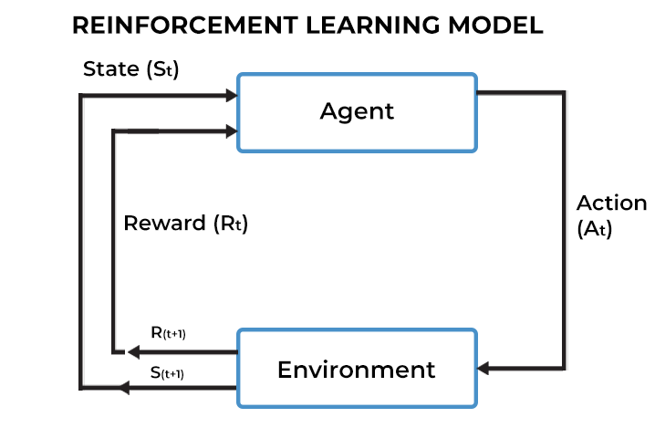
What is Reinforcement Learning?
Reinforcement Learning (RL) is all about training an Agent to take actions to maximise a Reward signal, within some environment.
RL problems are (almost) always formulated as a Markov Decision Process (MDP).

Slide 3
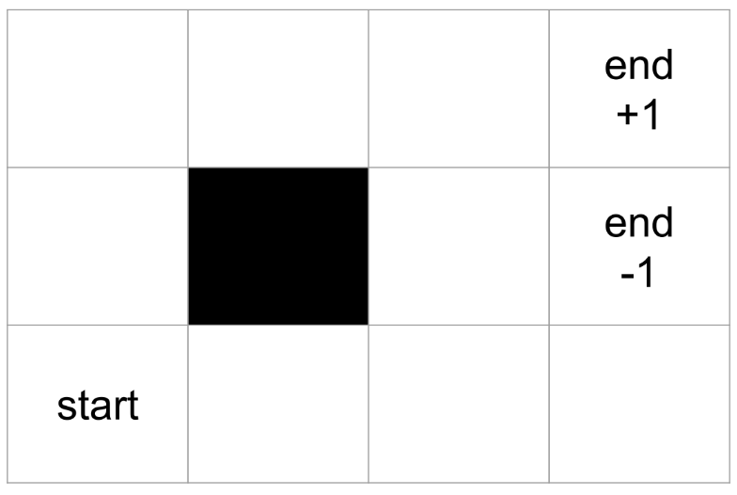
What is a Markov Decision Process?
Here is a very simple environment (often called a gridworld).
What are the states?
What are the actions?
What are the rewards?
This is also an episodic environment (the agent will only be in the environment until reaching a terminal state).
A good state should tell the agent everything it needs to know to choose an optimal action. (called the Markov Property)

Slide 4
So how do we get agents to solve a Markov Decision Process?
We use Reinforcement Learning!
Agents need a learn a policy. (A mapping from states to actions)
Reinforcement Learning is all about learning a policy which maximises the sum of future rewards.
One way of learning a policy is to learn a Value Function.
A Value function is a function which takes a state and predicts the sum of future rewards.
This idea can be extended, to learning State-Action values, which also take a state and an action, and predict the sum of future rewards by taking that action in that state (also called Q-Values).
This allows us to easily have a policy by simply choosing the action with the highest predicted value.

Slide 5
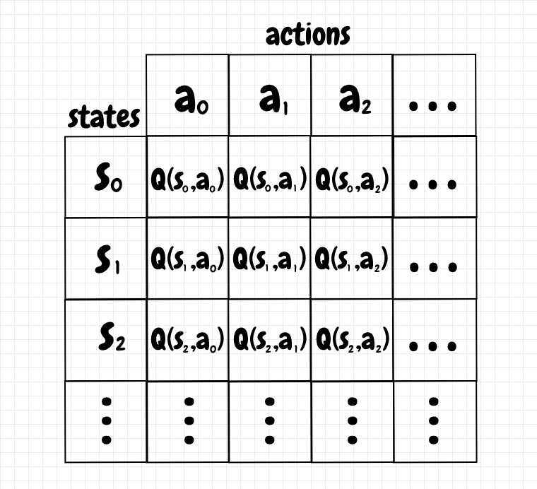
Q-Learning is a very popular RL algorithm Q-Learning looks to learn this Q-Table:
A0 = Right
A1 = Left
A2 = Up
A3 = Down
S7
S8
S9
S5
S6
S0
S1
S2
S3

Slide 6

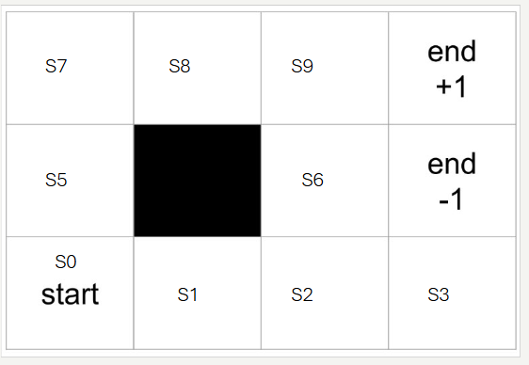
So how do we calculate Q(s, a)? Q-Learning!
Assume γ=0.9
 | Right | Left | Up | Down
S0 | 0 | 0 | 0 | 0
S1 | 0 | 0 | 0 | 0
S2 | 0 | 0 | 0 | 0
S3 | 0 | 0 | 0 | 0
S4 | 0 | 0 | 0 | 0
S5 | 0 | 0 | 0 | 0
S6 | 0 | 0 | 0 | 0
S7 | 0 | 0 | 0 | 0
S8 | 0 | 0 | 0 | 0
S9 | 0 | 0 | 0 | 0

Slide 7
More about RL and Q-Learning
Discount Rate – This controls how much we care about future reward. γ=1 means we care about all reward the same. γ=0 means we only care about the reward at the next step!
Exploration vs Exploitation Tradeoff – Q-Learning gives us a policy by picking the action with the highest Q(s, a). However, if our Q(s, a) function is bad, this isn't very useful! Sometimes we may choose to explore and pick a different action. For example, epsilon greedy is a technique for doing this.
The goal of Q-Learning is learn Q*, known as the optimal policy. Q* is a Q function where every Q(s,a) gives the optimal discounted sum of rewards.
Learning Rate – We may not always want to completely overwrite our current Q(s,a) when we get some new data. Instead, we may use a learning rate: Q(s,a) = learning_rate * (new Q(s,a)) + (1-learning_rate) * (old Q(s,a)) .

Slide 8
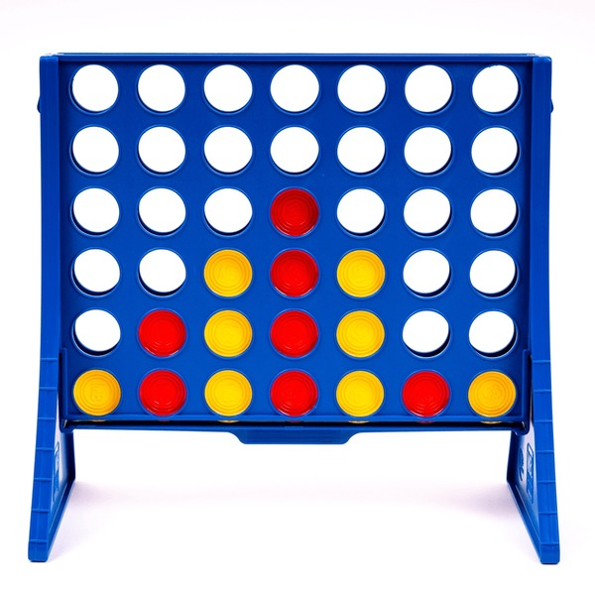
Limits of Tabular Q-Learning
Say we want to learn something more complicated than a gridworld, like connect 4:
How big does our Q-Table need to be?

Slide 9
Answer:
Each position can be red, yellow or empty
There are 7 columns and 6 rows
3^(42) possible states! (although many of these states are impossible)
In each state, there are 7 possible actions
7 * 3^(42) possible state-action pairs! = 7.66x10^(20)
I hope your computer has a lot of RAM :(

Slide 10
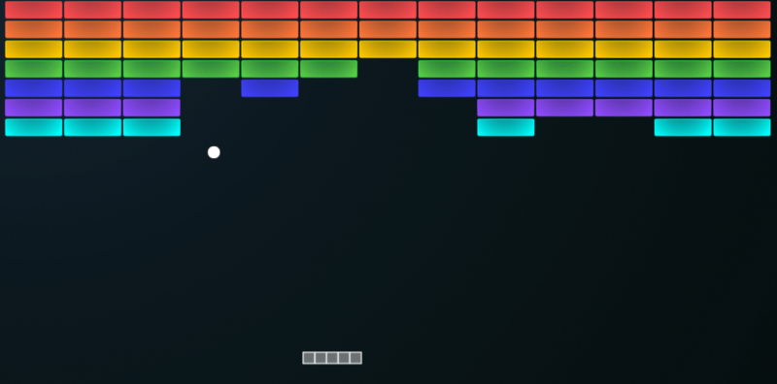
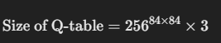
Deep Reinforcement Learning
Many Environments we want to solve are far too big to use a Q-Table.
For example, in many environments the state is simply the screen.
84x84 pixels (if we downscale the image)
Each pixel can be between 0-255 (assuming greyscale images)
Maybe 3 actions (left, right, nothing)
To get around that we can use Deep Reinforcement Learning
The idea of this is to use a Neural Network instead of a Q-Table
The neural network will take a State as input, and output Q-values for every different action.

Slide 11
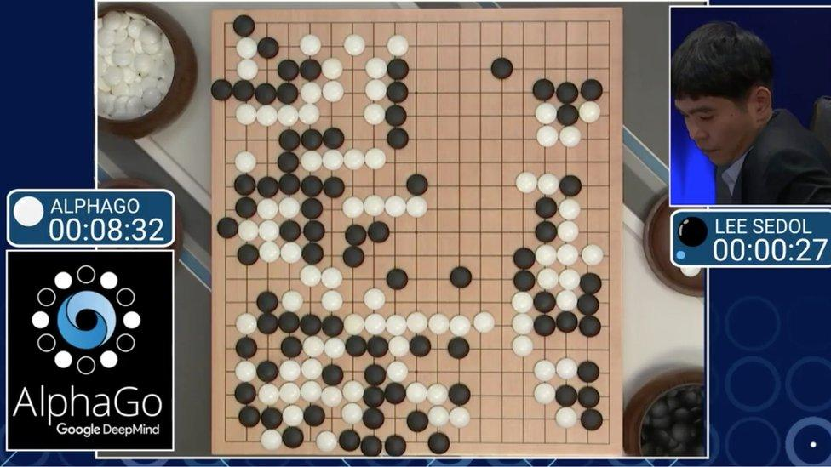
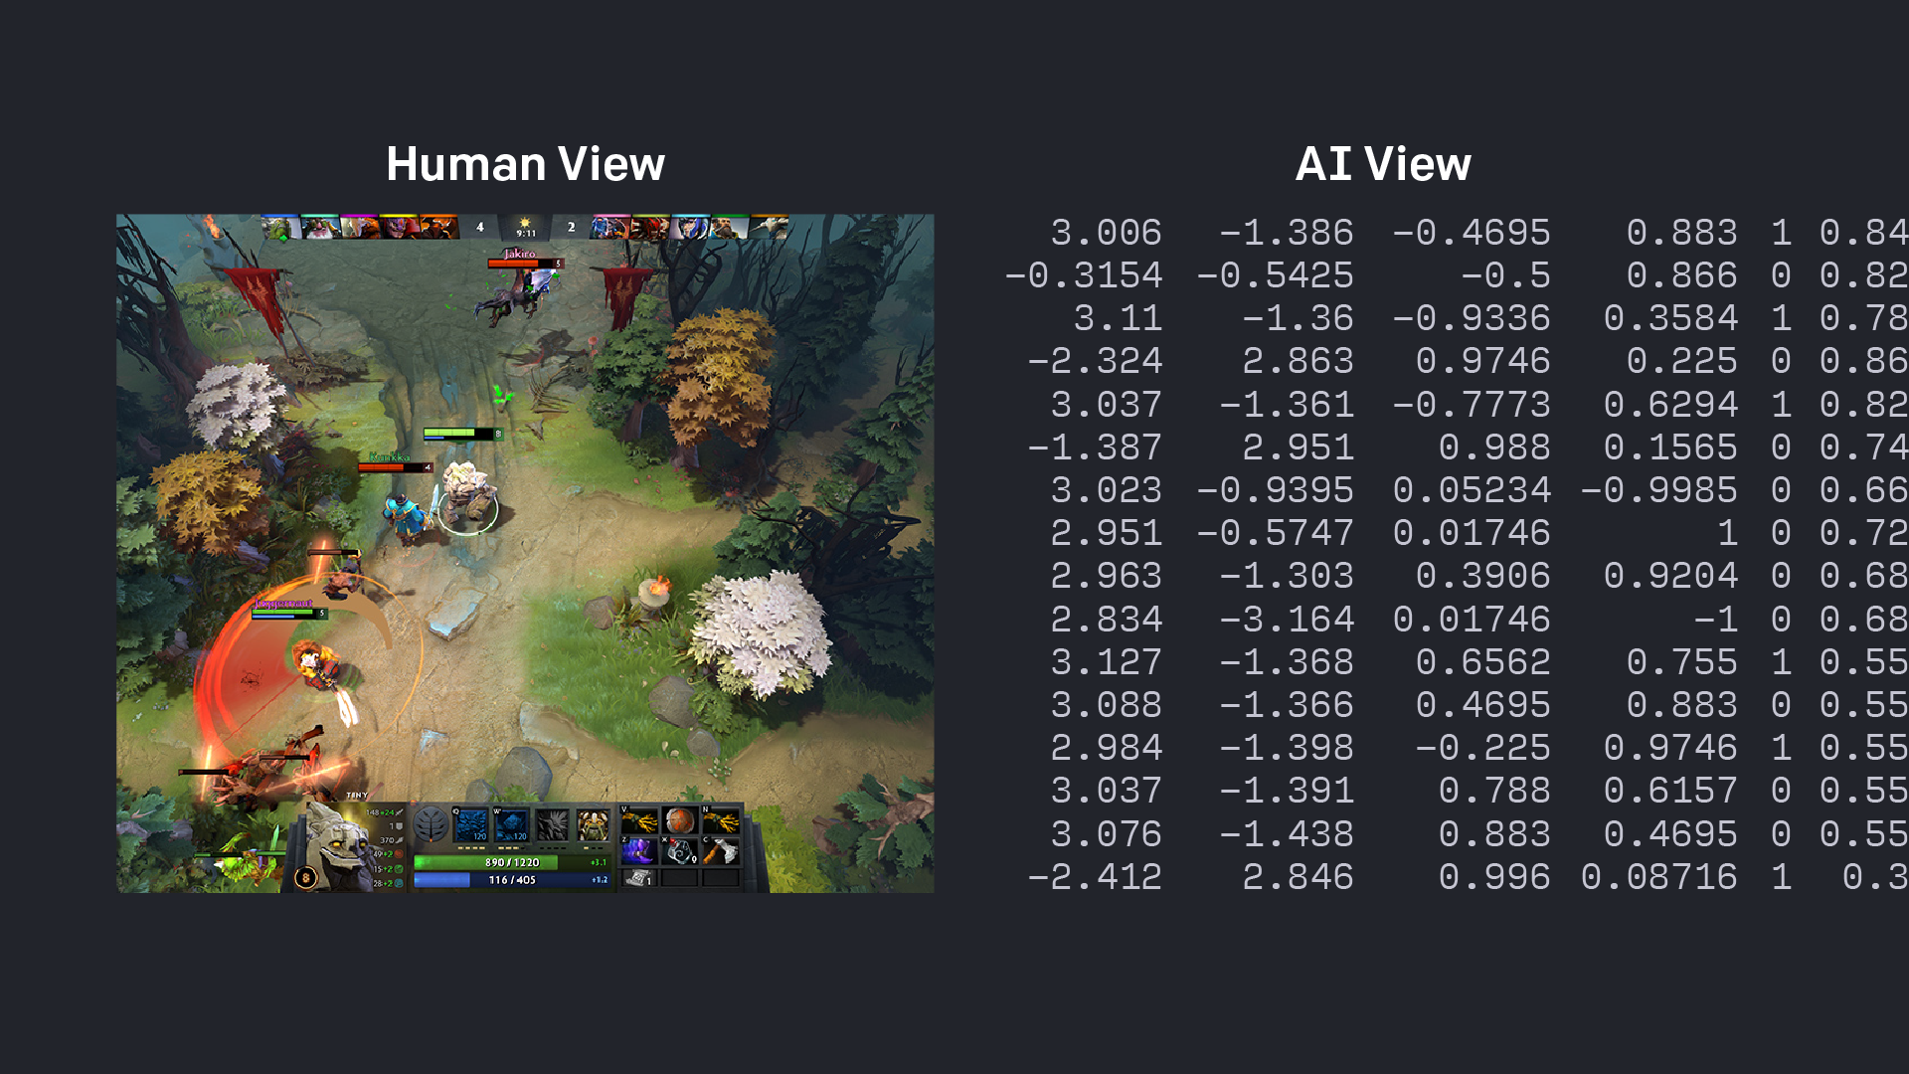
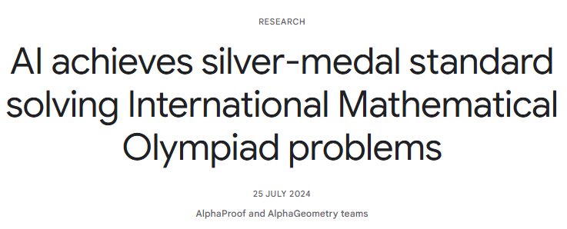
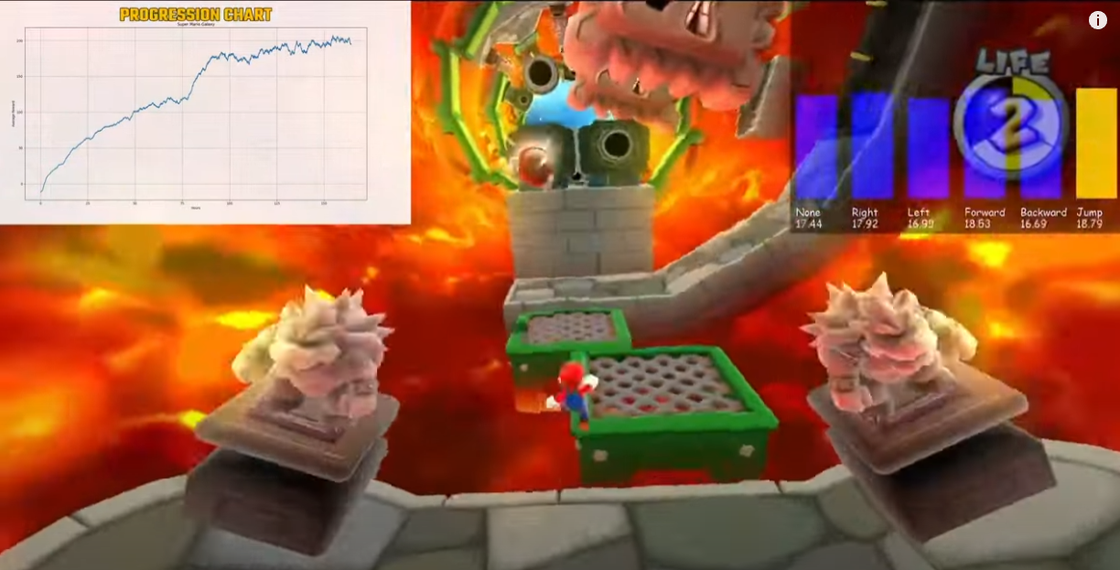
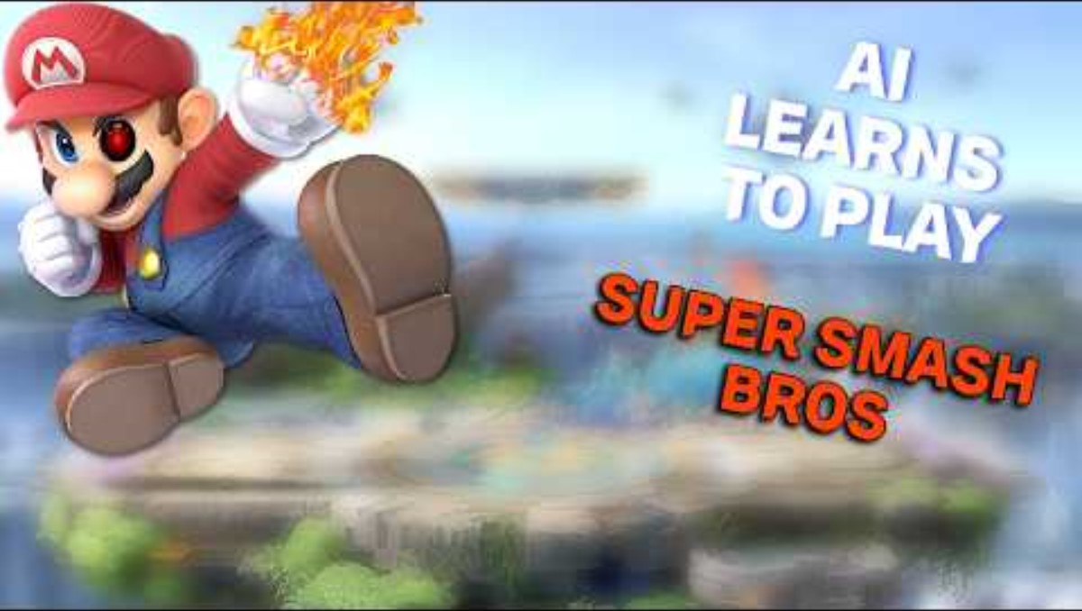
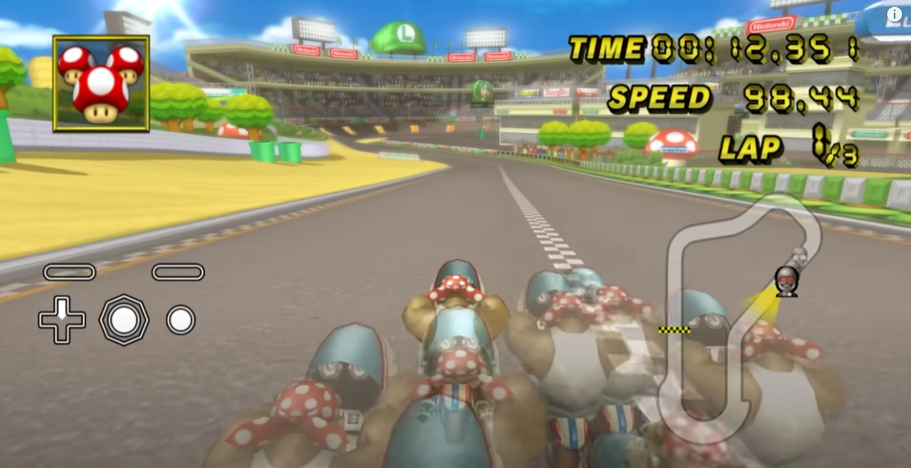
What Deep Reinforcement Learning has Achieved
Very shameless plug – AI Tango

Slide 12
Let's play around with our gridworld! But first, here's some helpful stuff
Basically all RL code uses a standard called Gymnasium (formerly gym). This defines environments in code like so:
env = GridworldEnv()
State, info = env.reset() - this restarts the environment, and returns the first state. (also a dict that you can store extras in)
state, reward, done, info = env.step(action) - this is what steps our environment forward
env.render() - this just displays the environment (text, gui, whatever you like).

Slide 13
A little game to play around with – Fight, Run or Hide!
You have some Health Points (HP), and some enemies who want to hurt you (don't try this at home).
Every timestep, you have the option to Fight, Run or Hide (who would've guessed that?)
If you Fight, you have a 50% chance to get a kill, and a 50% chance to lose 50 HP
If you Run, you have, 10% chance to get a kill, 20% chance to lose 50HP, 70% chance to gain 15HP
If you Hide, you have, 90% chance to gain +10 HP, 5% chance to lose 100HP, 5% chance to gain 2 kills
If you have 0 or less hp, the episode is terminated!
https://github.com/VIPTankz/RL_Workshop
pip install numpy; pip install matplotlib
What score can you get? What score can an AI get? Can you alter the code to add in the 4th action (crying)?
Who can get the highest score?

